Slide 1


Quantitative tools to analyze two-photon based calcium imaging data
Samsoon Inayat
Postdoctoral Fellow
Labs of Dr. Majid Mohajerani and Dr. Bruce McNaughton
May 27th, 2017

Slide 2
Workshop goals schedule – first 5-10 mins
Introduction
Calcium Imaging
Quantitative Analysis - Theory
Preprocessing
Image Registration → Motion correction
Segmentation and extraction of signal → Cellular vs neuropil
Deconvolution → Calcium signal to Spikes
Quantitative Analysis - Tools
CellSort, Suite 2P, ImageJ

Slide 3
Workshop schedule – ~45 mins Hands on
Time | Activity Name
05 mins | Introduction to Tutorial Folder … what’s where
05 mins | Visualizing Data
10 mins | Image Registration
05 mins | Segmentation and Extraction of Signal
05 mins | Deconvolution
15 mins | Suite 2P

Slide 4
Workshop schedule – q & A
Contact in the next 3 DAYS for help
samsoon.inayat@uleth.ca
samsoon.inayat@gmail.com

Slide 5
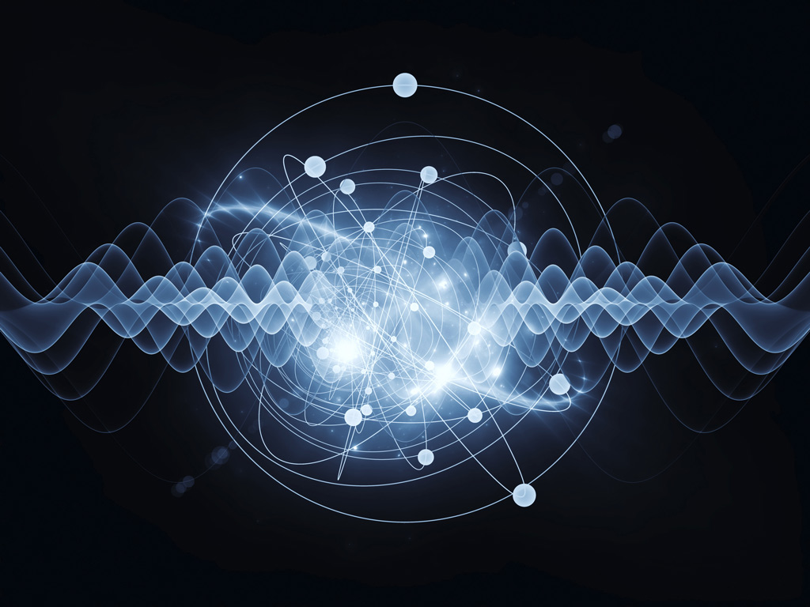
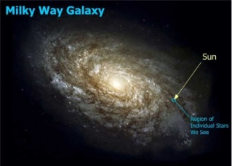
Cognitive – model – measurement scales
Quantum
Galactic / Astronomical
Quantum Foam Planck Length 10⁻³⁵ m
End of Greatness
300 Million Light years

Slide 6
Calcium imaging
Pachitariu et al 2016, Bioarxiv

Slide 7
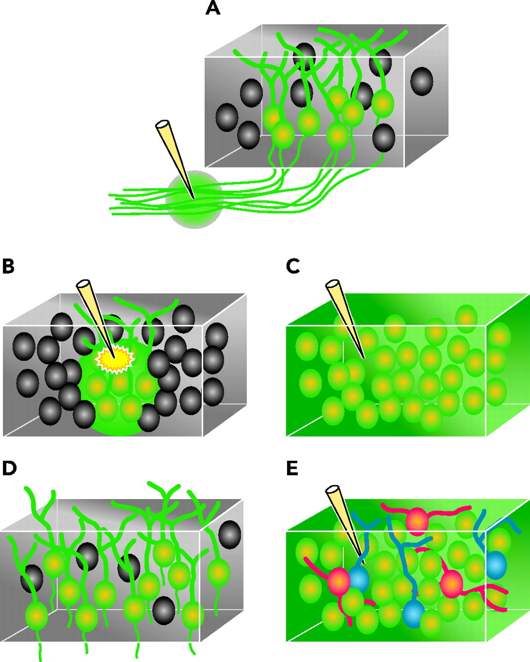
Calcium imaging
Two Photon Microscope
Calcium Sensors

Slide 8
Two-photon microscopy
Courtsey Ju Lu UCSC

Slide 9
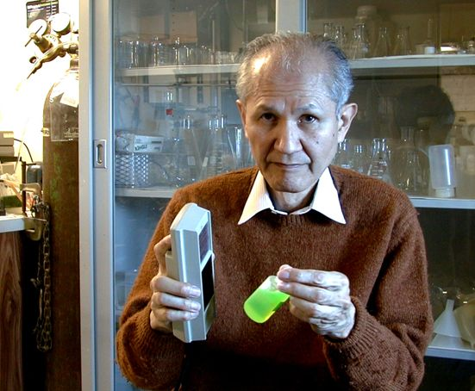
Two photon microscopy – calcium sensors
Genetic Indicators
GCaMP3
GCaMP6 and variants
Synthetic Indicators
OGB1-AM
Cal520
Osamu Shimomura

Slide 10
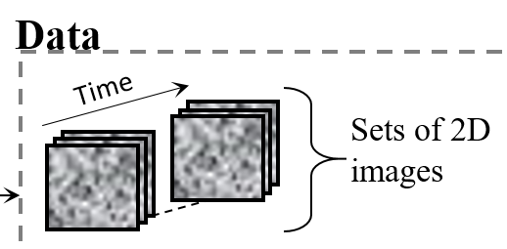
Two-photon optics – data acquisition

Slide 11
Analysis - Steps
Load Data → Visualize Data →Analysis to identify cells and obtain cellular signals
Image Registration
Motion correction
Alignment between stacks from multiple days
Segmentation and signal extraction
Deconvolution

Slide 12
Eventual goal

Slide 13
Workshop activity
Load Data
Find average image and max image
Image Registration
Manual ROI drawing and obtaining signal
Using Cell Sort from Mark Schnitzer Group
PCA
ICA
Segmentation
Deconvolution
Suite2P

Slide 14
Image registration
Rigid-Body
Registration Algorithms
TurboReg (ImageJ plug-in)
Imregister (Matlab) → recent
Sub-pixel DFT approach (Matlab)
By Manuel Guizzar
Other Algorithms
HMM (Dombeck et al. 2007)
Lucas-Kanade approach (Greenberg and Kerr, 2009)

Slide 15
Analysis steps after image registration

Slide 16
Principal and independent component analysys

Slide 17
Principal and independent component analysys

Slide 18
Principal and independent component analysys

Slide 19

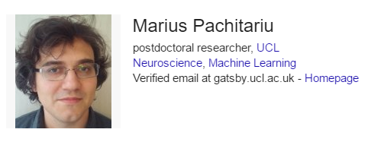
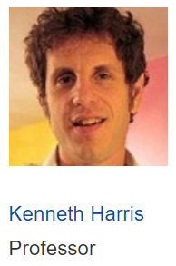
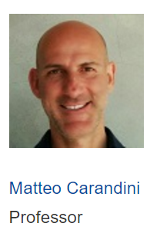
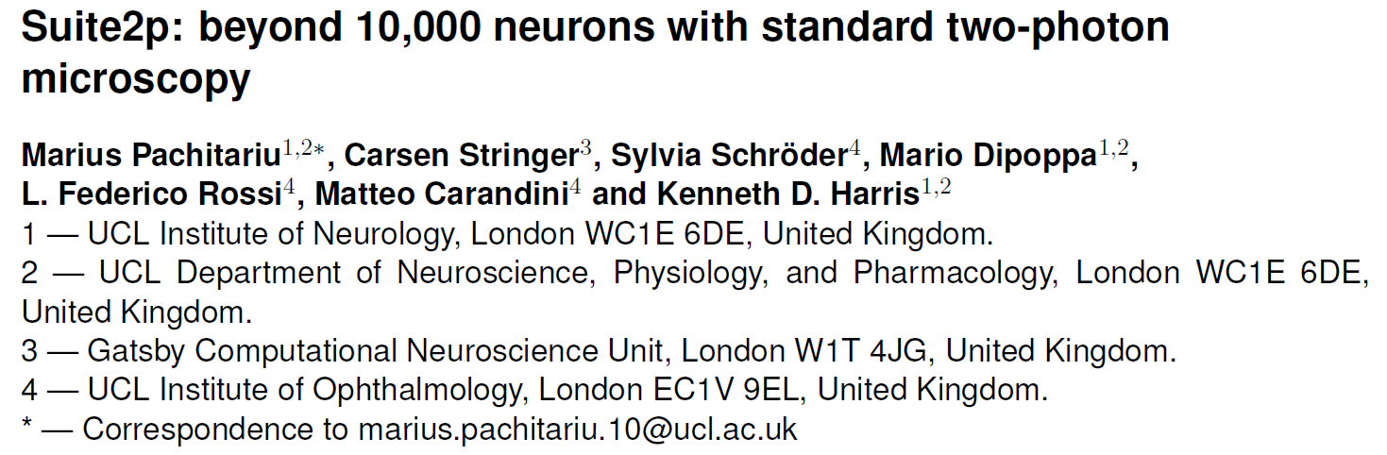
Suite2p

Slide 20
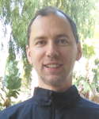
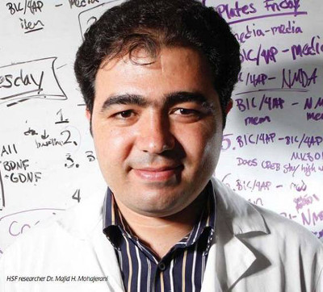

Acknowledgements
Dr. Artur Luczak
Dr. Majid Mohajerani
Dr. Dun Mao, Postdoctoral Fellow CCBN, University of Lethbridge

Slide 21
Thank you

